Slide 1

Speed Vision: A Deep Learning Based Approach for Car Speed Estimation
by
Arshi Naaz(A23009) Bidisha Sadhu(A23012) Jayeeta Choudhury (A23022)
Nancy Lahiri (A23025) Siddharth Tiwari (A23039) Matta Sai Mohan Ranga (A23024)
Under the supervision of
Dr. Subhasis Dasgupta
Praxis Business School, Kolkata, India

Slide 2

Key Content
Introduction
Business Objective and Data problem
Related Work
Contribution
Methodology
Results and Analysis
Conclusion

Slide 3

Introduction
Ensuring road safety is a top priority
Monitoring and regulating vehicle speeds pose challenges
Traditional speed detection methods are costlier and require heavy computation
Urgent need for comprehensive and advanced approach to speed detection

Slide 4

Business Objective
To develop an integrated system that can use AI based model to estimate the speed of a moving vehicle (car)
To be able to deploy the system in a cheaper handheld device so that real-time speed detection can be done at any location

Slide 5
Data Problem
The business problems are further broken down to these data problems :
Identification of vehicle within a frame with bounding box
Identify the change in bounding box area as the car is moving
Calculate the time between the first and last frame, when the vehicle is detected
Estimate the distance between the vehicle and the camera in each frame
Use the extracted features for speed estimation

Slide 6
Related work
Speed Estimation Using Doppler effect:
Frequency shift measures vehicle speed using radar or lidar.
These methods rely on concepts related to physics and depends on transducers.
This approach is complex and requires specialized equipment.
Two Lines Algorithm (TLA):
An individual uses stopwatch as the vehicle crosses the lines
Measures time between two lines, known distance for accuracy.
Often lacked precision and required manual intervention

Slide 7
Contribution
Proposing a new method by integrating two deep learning architectures.
Object Detection: Precise vehicle classification, bounding box area, and time calculation.
Depth Estimation: Utilizing MiDaS and Mask R-CNN for getting centroid pixel distance.
Non-linear regression model: To understand the relationships among features.
Finally proposing a new method to estimate speed

Slide 8

Project Objectives
Utilize YOLOv8 and OpenCV for vehicle identification, area and time computation
For Depth Estimation integrate MiDaS along with Mask R-CNN
Compute the speed of the vehicle using linear and nonlinear regression
Conduct comparative analysis with SSD and YOLOv5

Slide 9
Pretrained Models Used
YOLO(You Only Look Once):
Object Detection Algorithm
Predicts bounding boxes and class probabilities for image grids in one go.
Offers real-time object detection with high accuracy.
SSD (Single Shot MultiBox Detector):
Object Detection Algorithm.
Predicts bounding boxes and class probabilities across multiple feature maps.
Ensures efficient object detection with speed and accuracy

Slide 10
Pretrained Models Used
MiDaS:
Depth estimation algorithm
Depth estimation-process of objects in a scene from a given viewpoint.
Output- A 2D depth map, each pixel has an assigned depth value(distance of the point from camera)
Mask R-CNN:
Extends Faster R-CNN by adding a branch for predicting segmentation masks.
Simultaneously detects objects and generates high-quality segmentation masks for each instance.

Slide 11

Methodology - Data Acquisition
Videos are captured using mobile devices having 640x480 resolution
Curated a diverse video dataset of 90 data points, captured from front or side perspectives.
Videos range from 3 to 7 seconds, providing a simulation of traffic scenario

Slide 12
Methodology - OpenCV Integration
Integrate OpenCV for seamless video input into the model.
Initialize a video capture object to read frames from an input video file
Output of OpenCV was stored in a separate CSV file as extracted features

Slide 13
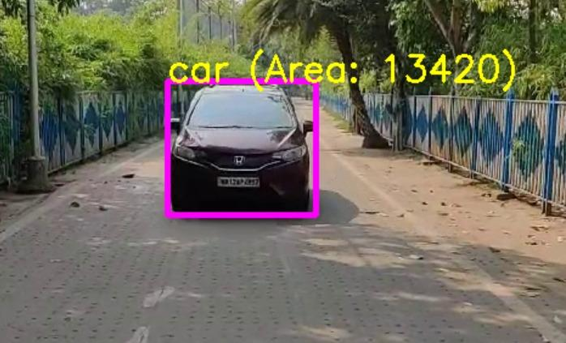
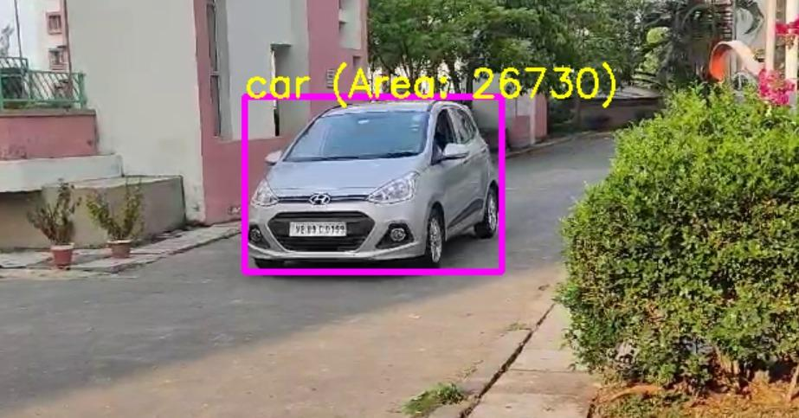
Methodology - Object Detection
YOLOv8 pretrained model is used to identify the object with a confidence threshold of 0.7.
The coordinates of the bounding box are taken for area calculation.
Time between the first frame and the last frame is calculated.

Slide 14
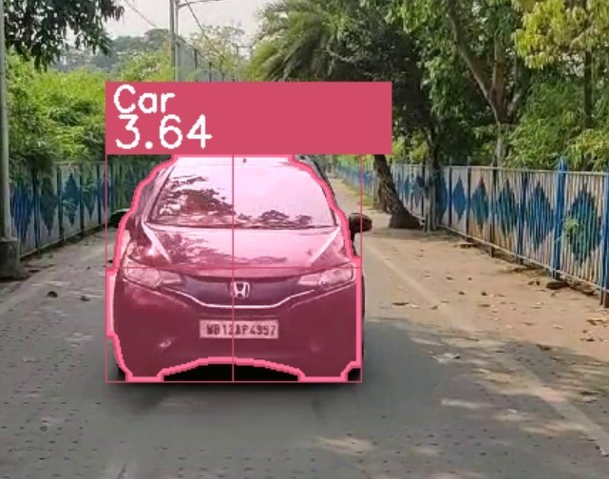

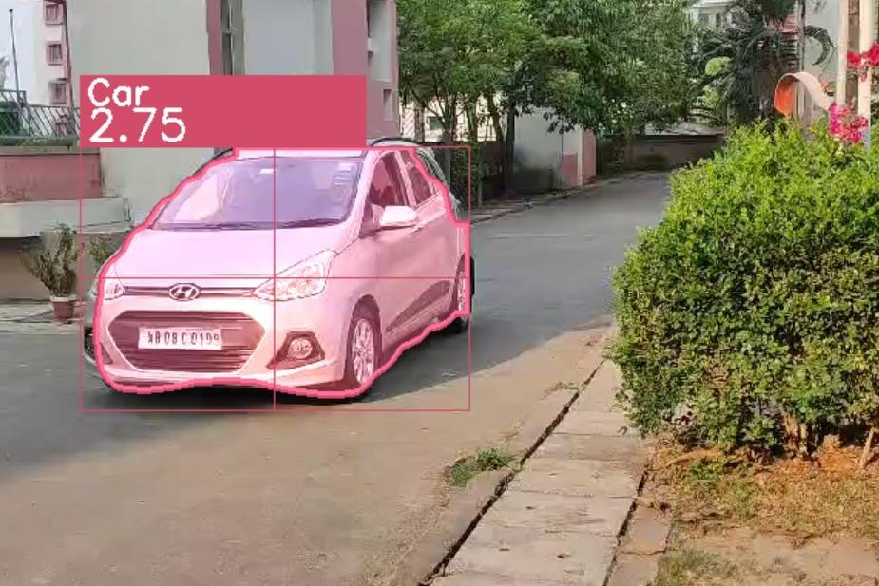

Methodology - Depth estimation
Integrated Midas for depth estimation, further refined with Mask R-CNN.
Overcame challenges of obtaining accurate depth values due to static backgrounds.
The masked object’s centroid is found and the pixel distance is computed only for the centroid pixel.

Slide 15
Methodology - Linear Regression
Developed code to extract area, time, and depth information from the respective models.
Two CSV files are formed as output which are merged for further analysis.
OLS is conducted to see the linear relationship among the variables
Case 1: X=[Area, Time], y=[Actual Speed]
Case 2: X=[Area, Time, Diff], y=[Actual Speed]

Slide 16
Methodology - Nonlinear Regression
Degree 3 Non Linear polynomial regression is computed
Case 1: X=[Area, Time], y=[Actual Speed]
Case 2: X=[Area, Time, Diff], y=[Actual Speed]

Slide 17
Methodology-Model Evaluation and Selection
Evaluated linear and non-linear regression models, focusing on adjusted R-squared values, MSE and RMSE
Selected YOLOv8 non-linear regression model for superior predictive capabilities.

Slide 18
Methodology-Speed Prediction and Validation
The model is exported using a joblib file ( YOLO v8 non-linear regression model for speed estimation)
New datapoints is used to estimate the speed
Validated predictions using front and side angle video datasets.
Compared predicted speeds with known ground truth speeds for accuracy assessment.
SSD and Yolov5
The same process is being used for SSD and YOLOv5, ensuring consistency and comparability across different object detection models

Slide 19
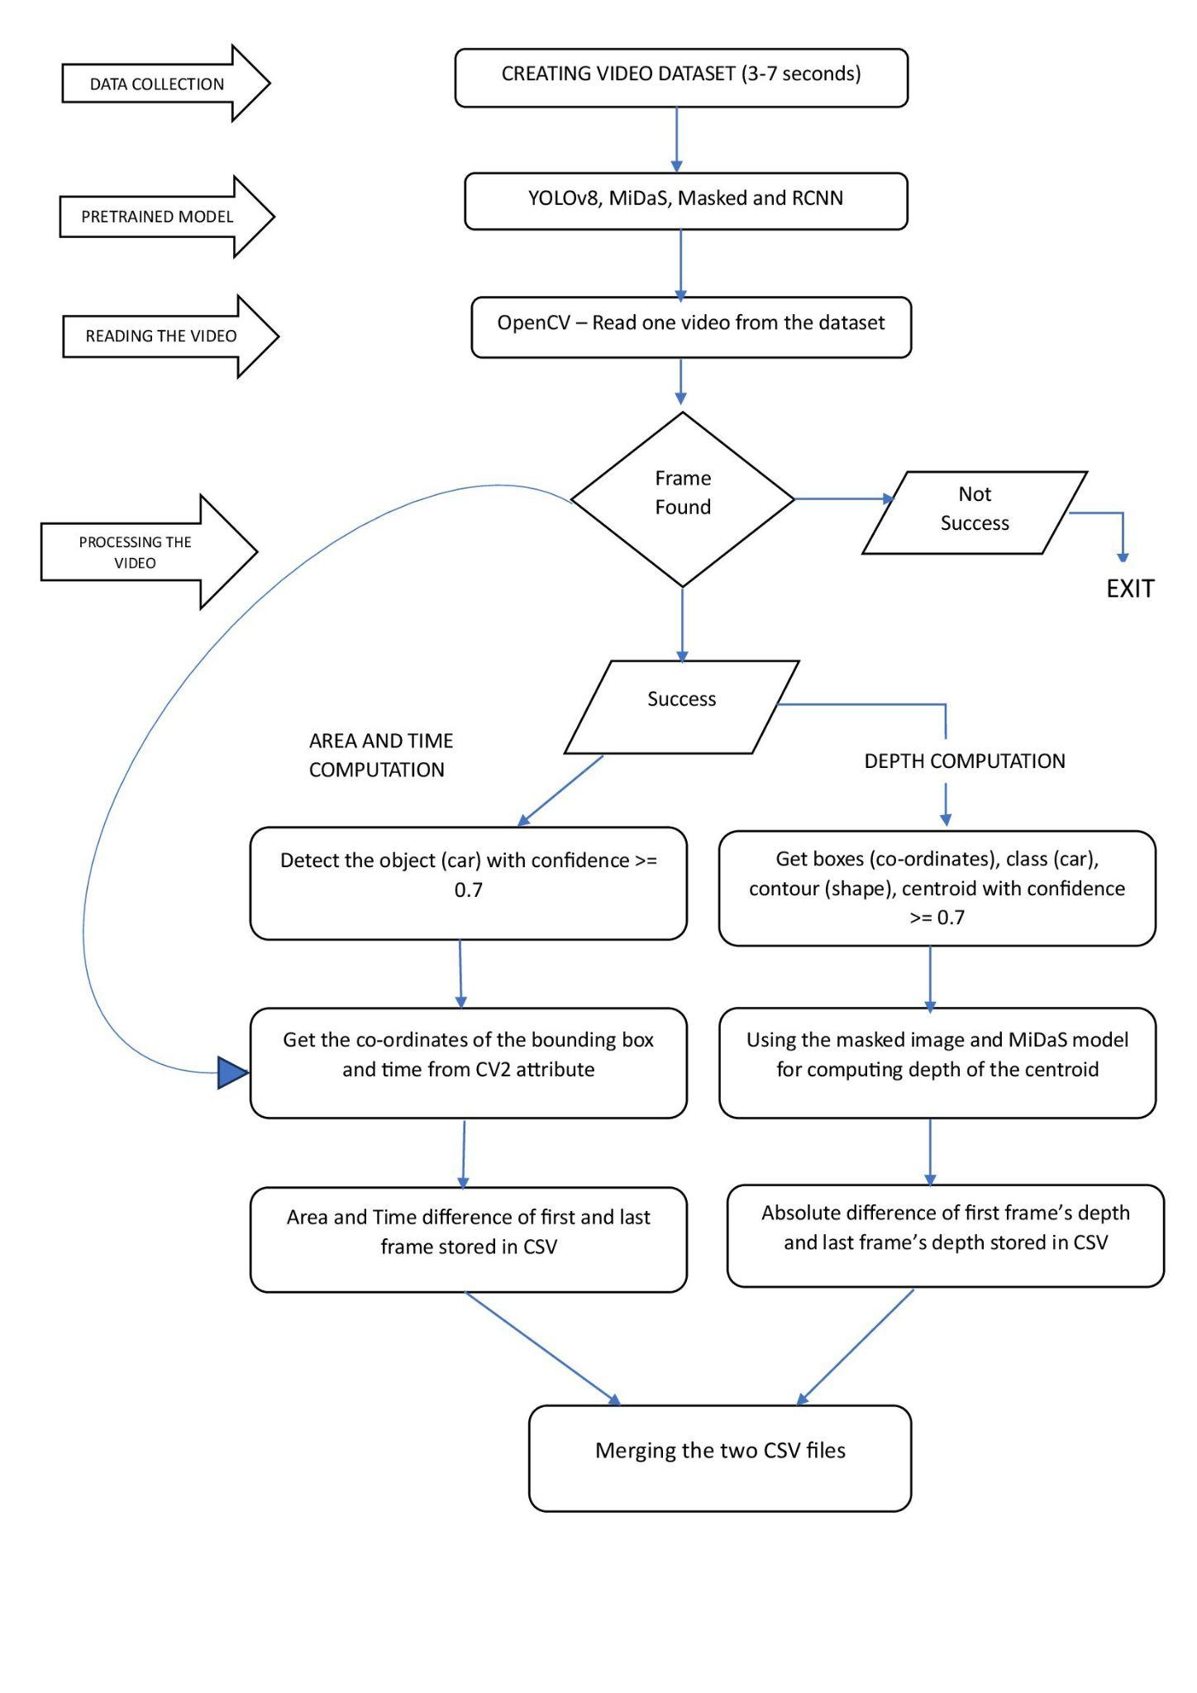
Methodology
Architecture Diagram

Slide 20
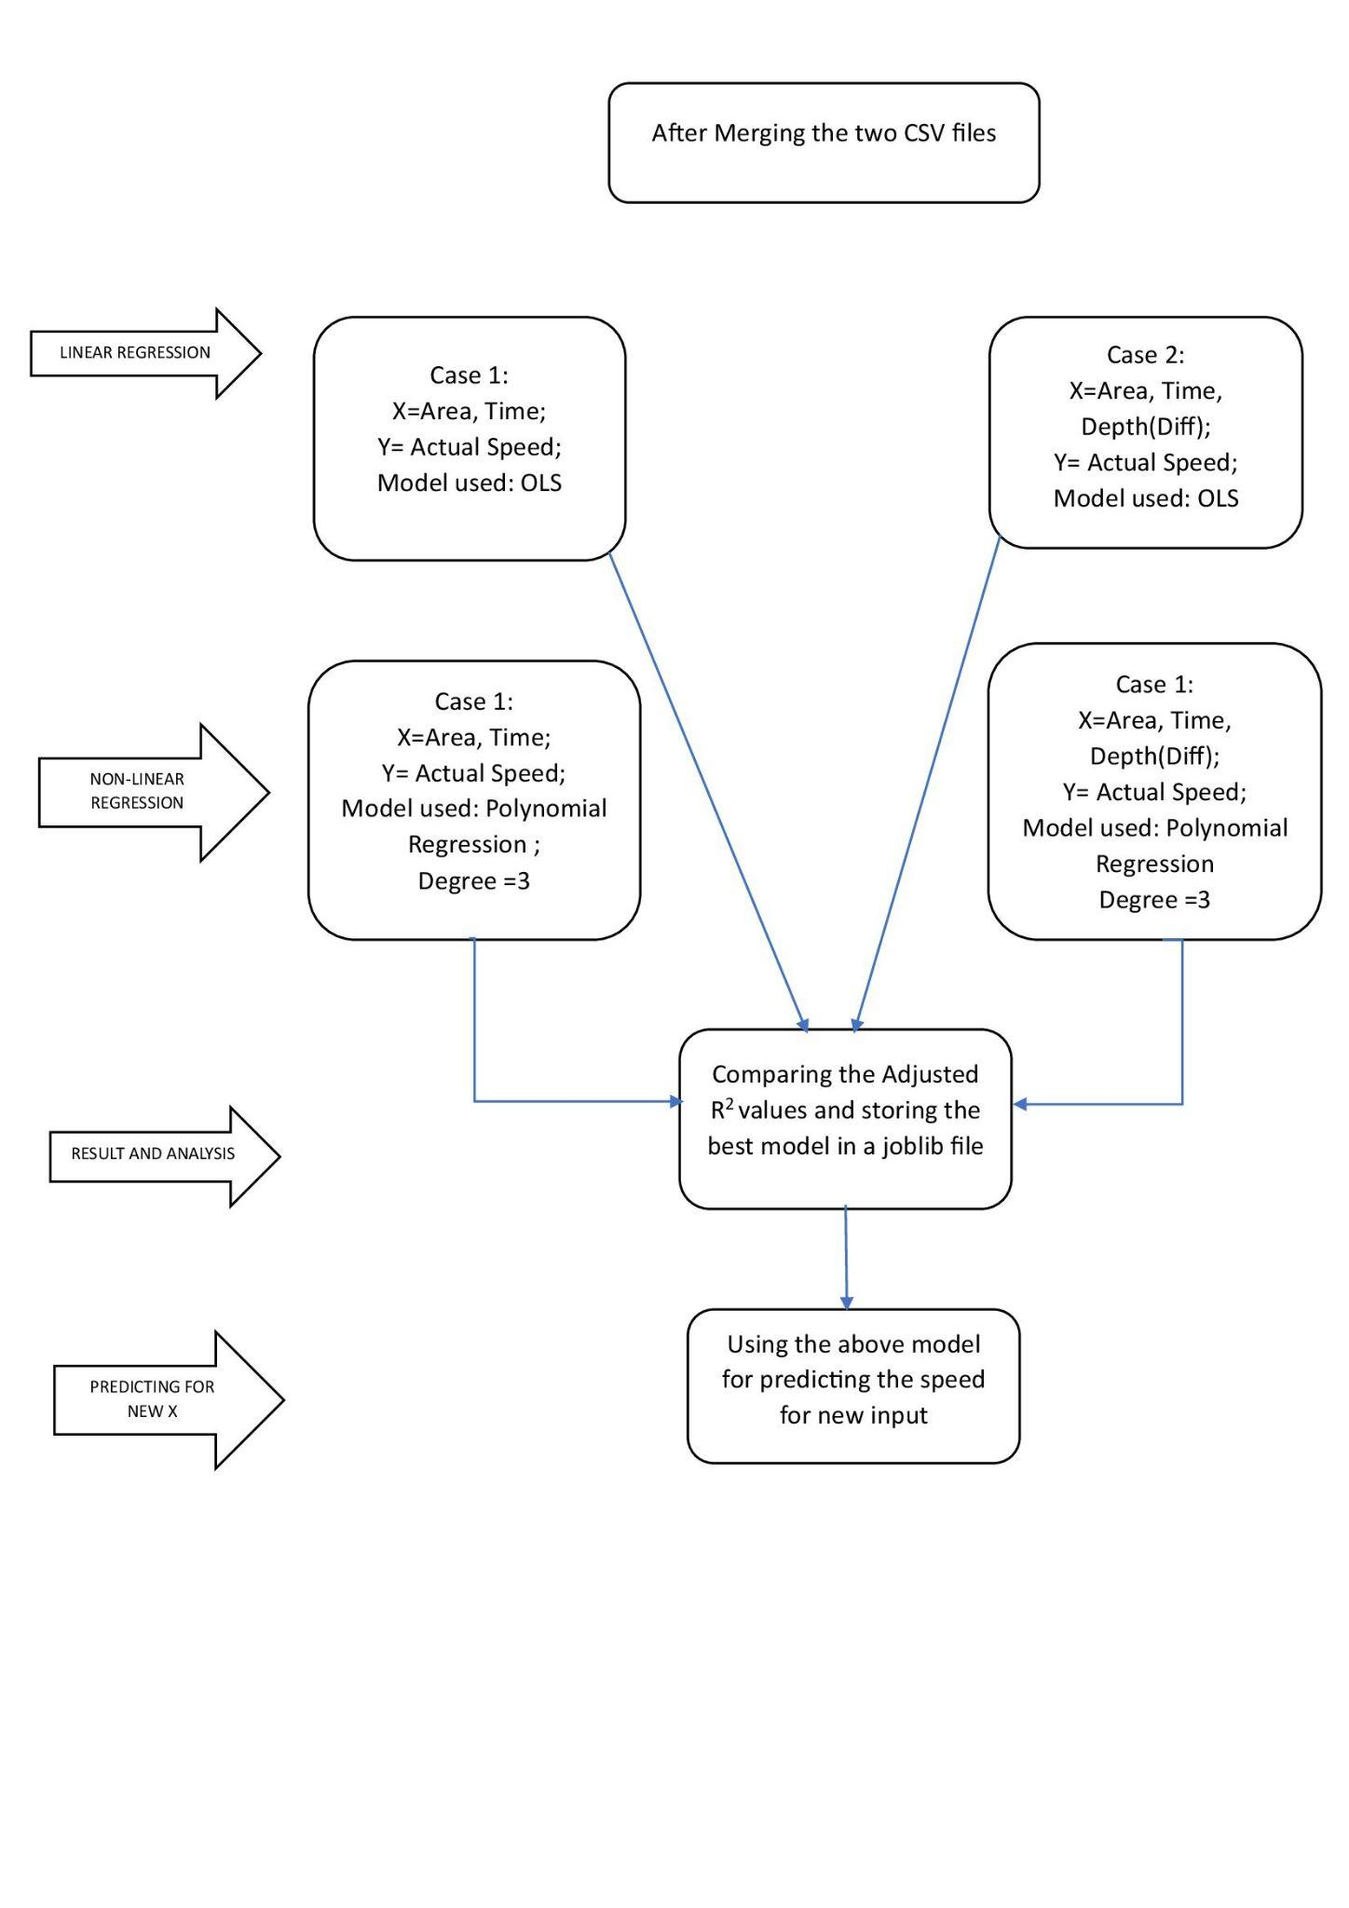
Methodology

Slide 21
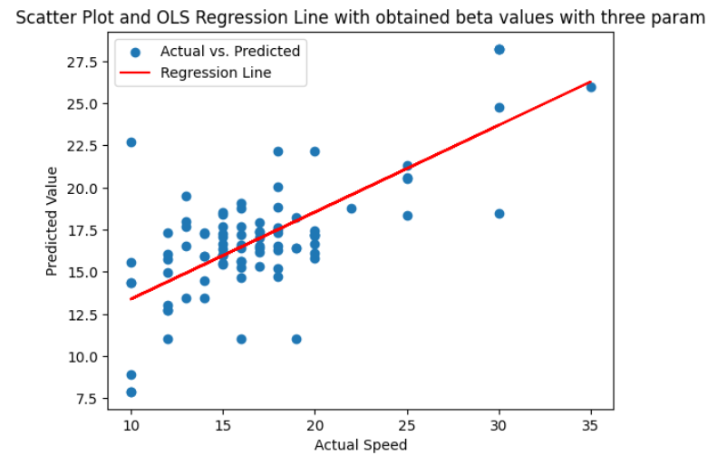
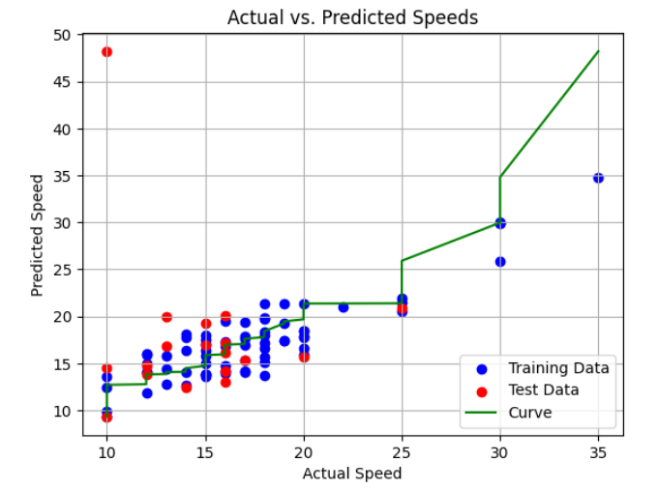
Results and Analysis
Impact of Depth on Model Accuracy:
Addition of "diff" variable (depth) improved speed prediction accuracy in all models
YOLOv8 showed highest accuracy with depth, followed by YOLOv5 and SSD
Linear and nonlinear regression models performed better with depth inclusion
Plotting of actual and predicted speed in linear and non-linear YOLOv8 model

Slide 22
Results and Analysis
Model Name | Regre-ssion | AdjR² without diff | AdjR² with diff | R²with diff | MSE with diff | RMSE with diff
YOLOv8 | Linear | 0.23 | 0.50 | 0.52 | 12.29 | 4.90
 | Non Linear | 0.61 | 0.74 | 0.81 | 5.02 | 2.24
YOLOv5 | Linear | 0.15 | 0.45 | 0.47 | 26.82 | 5.18
 | Non Linear | 0.15 | 0.66 | 0.76 | 6.24 | 2.50
SSD | Linear | 0.13 | 0.46 | 0.48 | 27.90 | 5.28
 | Non Linear | 0.20 | 0.60 | 0.72 | 7.34 | 2.71

Slide 23
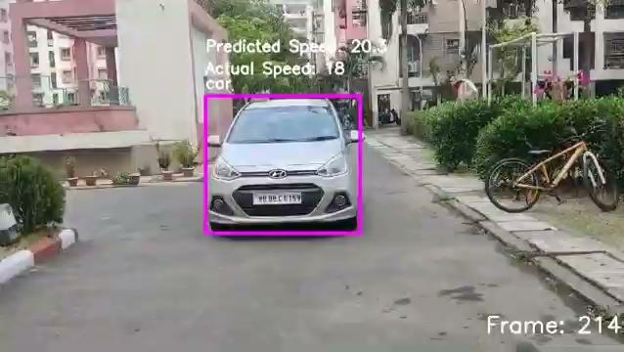
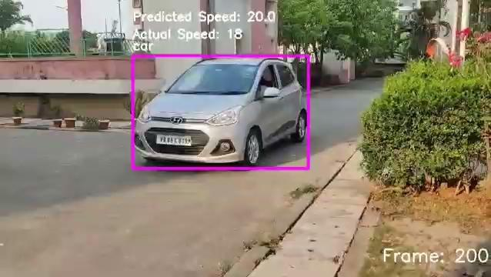
Results and Analysis

Slide 24
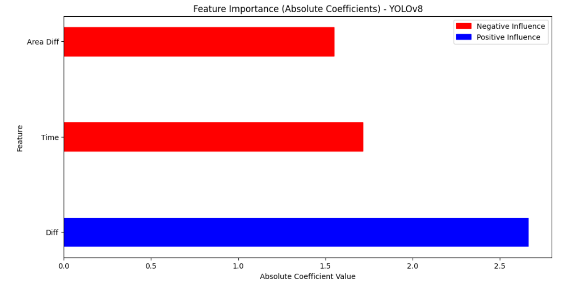
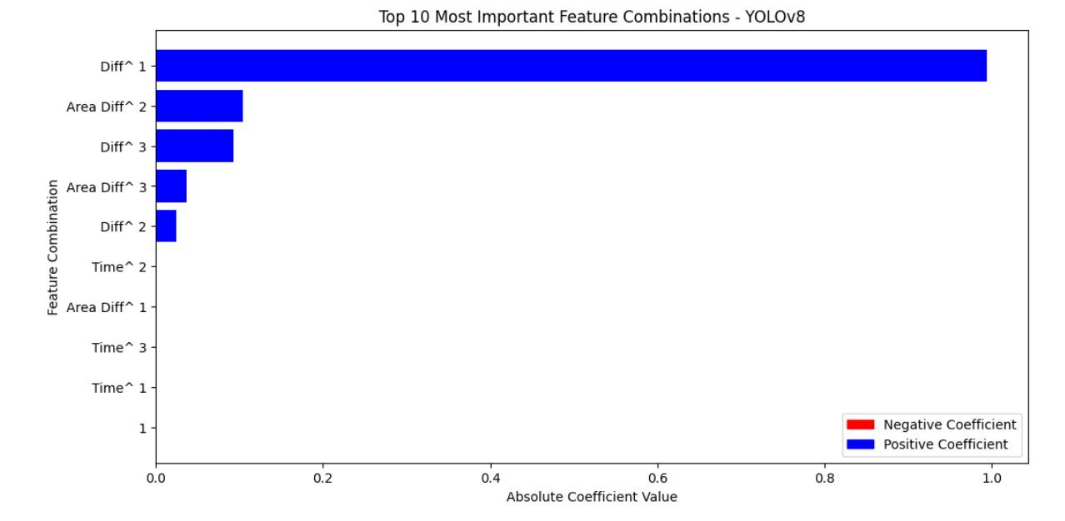
Results and Analysis
Best Features:

Slide 25
Results and Analysis
Model Performance Comparison:
Evaluated model performance using Adjusted R-squared, Mean Squared Error, and Root Mean Squared Error
Compared linear and nonlinear regression results for each model
The best features in both the regression models (YOLOv8) are obtained.
Concluded with YOLOv8 as the most accurate model for speed prediction when considering depth.

Slide 26
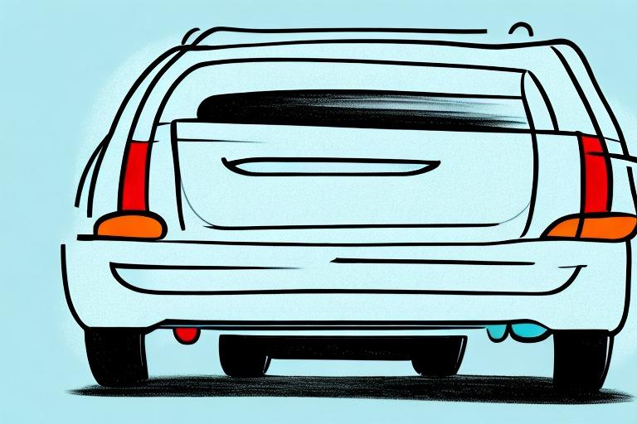
Conclusion
This work presents a new way to estimate speed using two Deep Learning algorithms
Non-linear regression showed high adjusted R-squared values, indicating that accurate speed estimation is possible even with a small dataset.

Slide 27
Future work
In future we can extend our work in heavier vehicles as well as smaller ones, aiming to enhance road safety impact.
Future plans include expanding our dataset with a larger number of data points.
This expansion aims to improve model fine-tuning, enhancing predictive accuracy and optimization for real-world applications.

Slide 28
THANK YOU

